Slide 1

Arduino smart car
philippe.baetens@altran.com

Slide 2
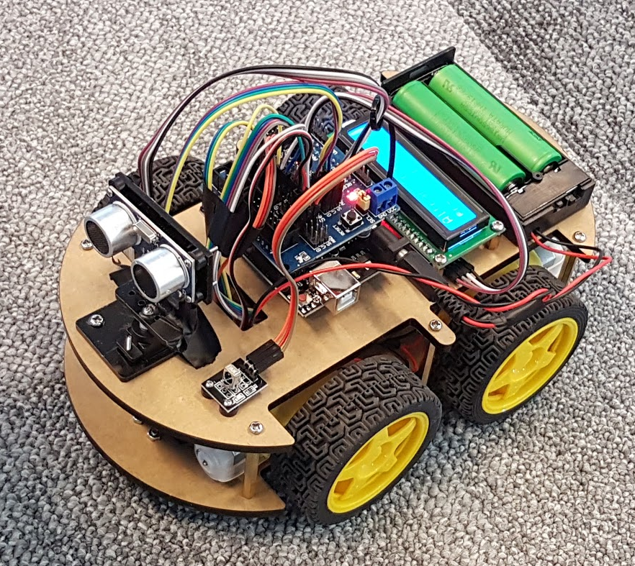

Slide 3
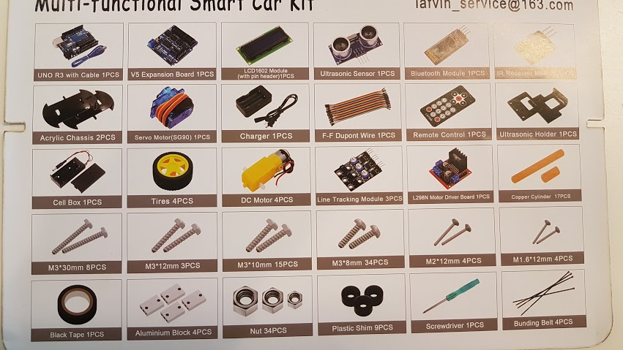
What’s in the box

Slide 4
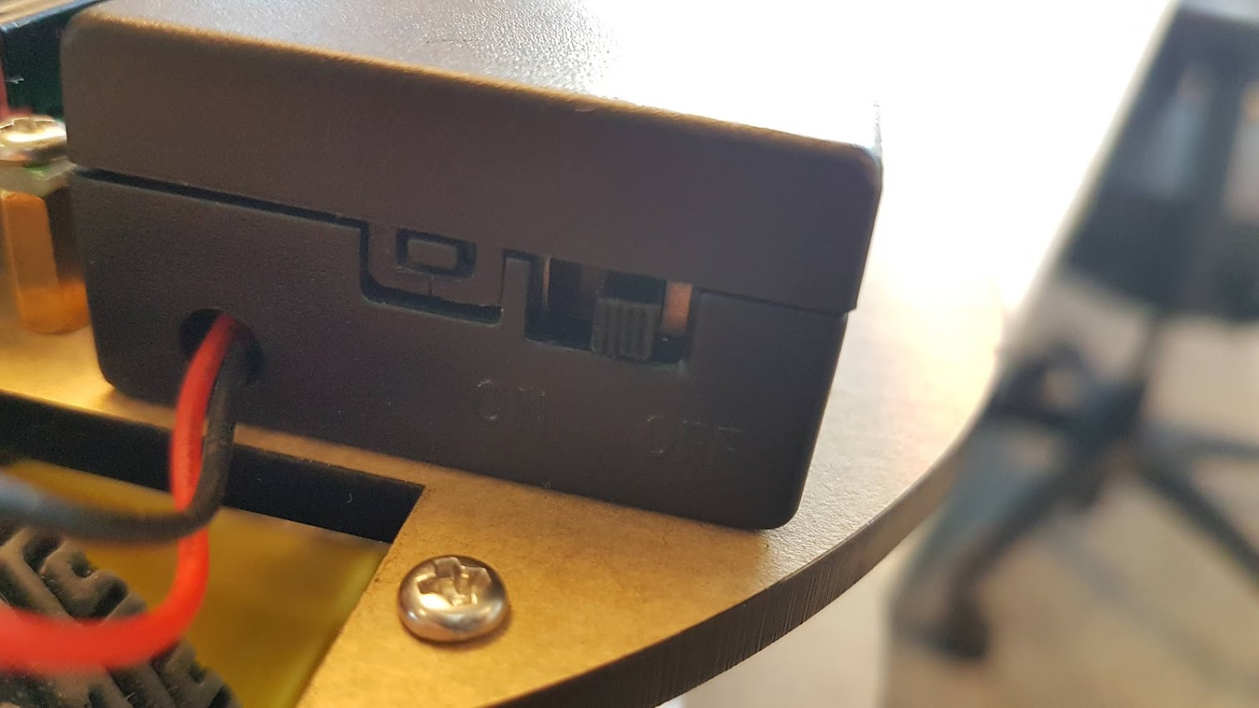
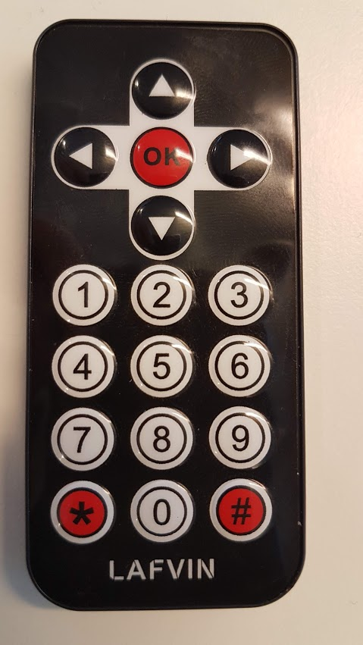
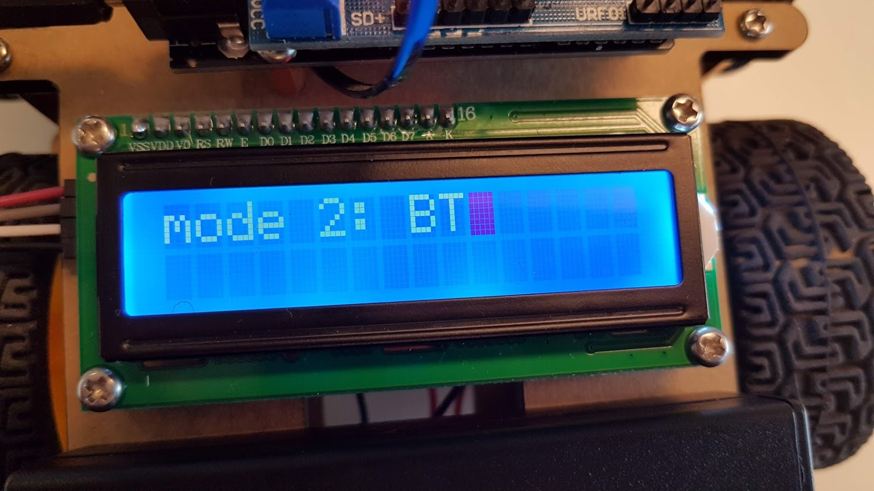
Using the car
Turn on power
Select mode using IR remote
1 = obstacle avoidance
2 = smartphone controlled driving (BlueTooth)
3 = line tracking (not implemented)
0 = STOP
arrows and OK button can also be used to control the car with the IR remote

Slide 5
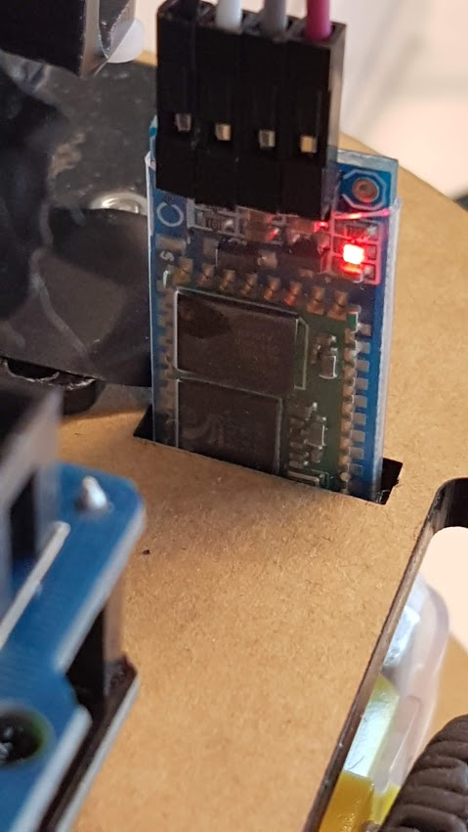
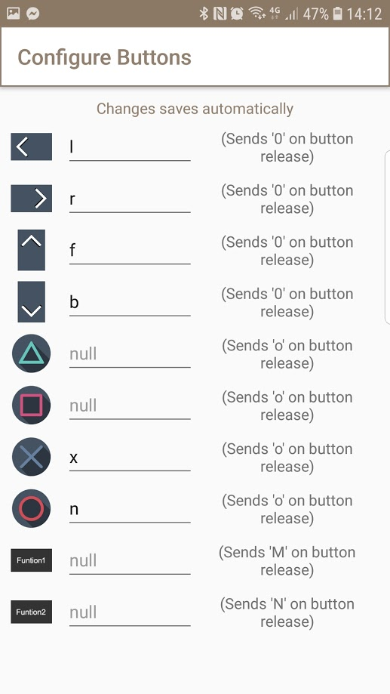
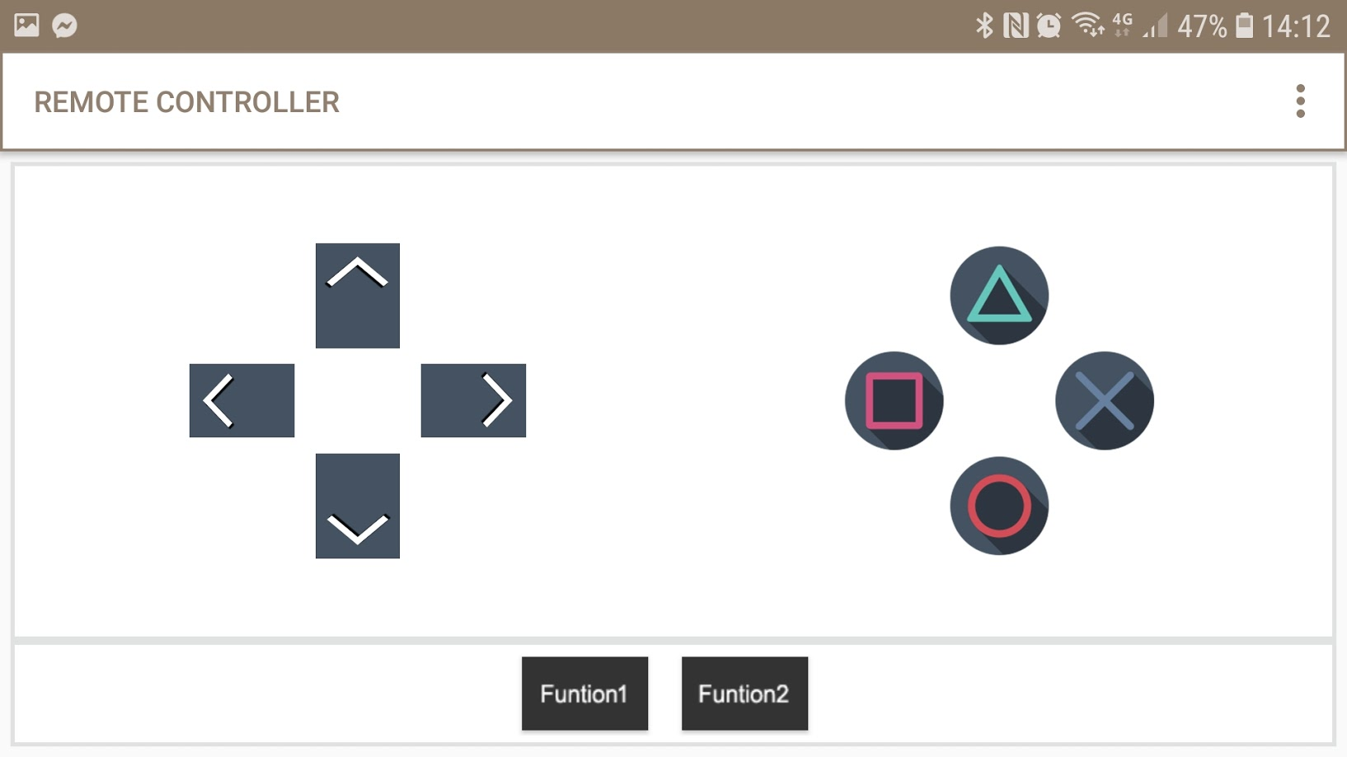
Setting up your phone for BT control
Download the app: https://play.google.com/store/apps/details?id=com.satech.arduinocontroller https://itunes.apple.com/us/app/ble-joystick/id1098200556 https://play.google.com/store/apps/details?id=com.giumig.apps.bluetoothserialmonitor&hl=en
Connect to the bluetooth module on your phone (HC-06) blinking light means ready to connect
When HC-06 is in the list of paired devices, go to the app you downloaded.
Go to options and assign correct letter to each button: l, r, f, b, x

Slide 6
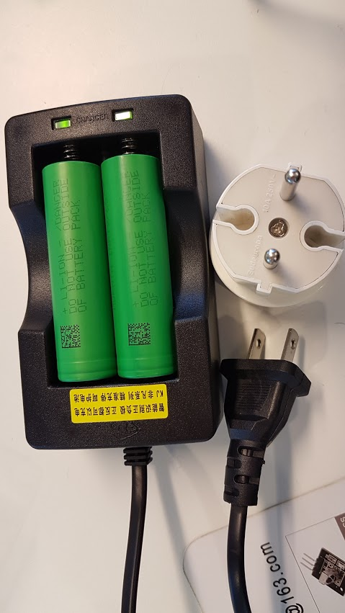
Charging batteries
Use US-EU adapter and charger
Watch the polarity of the batteries
These batteries can give 20A, be careful

Slide 7
Links
Find all code, examples, documentation on
https://github.com/fiepfiep/smartcarproject
Demo on youtube
https://www.youtube.com/watch?v=sbT1NxYCtAc https://photos.app.goo.gl/VQ7f5MwMEq8ZzyCL8
Contact
philippe.baetens@altran.com

